Slide 1


ITU NovaNexus
A Case Study in Unified University Systems Architecture
Project by Muhammad Abdul Qadir & Muhammad Samad. | December 2025

Slide 2






The Challenge: Fragmented University IT Systems
Many universities use disparate, legacy systems, leading to significant inefficiencies.
Walled-off information
Administrative Friction
Information is spread across disconnected platforms.
Workflows are slow, manual, and error-prone.
Lack of Scalability
Old systems struggle with peak loads, like enrollment periods.

Slide 3
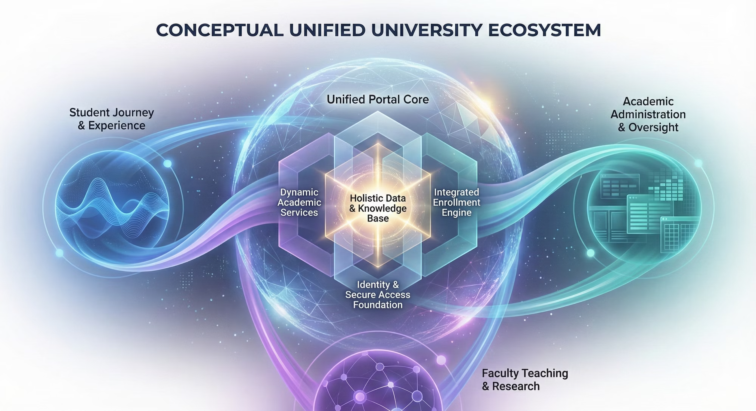
The Solution: Unified University Ecosystem
Our goal is to create a single, integrated platform connecting all university facets, centered around a holistic knowledge base.

Slide 4



Multi-Portal Experience
ITU NovaNexus consolidates university functions into three distinct, role-based portals for administrators, faculty, and students.
Admin Portal
Faculty Portal
Student Portal
Secure login
Faculty authentication
Student authentication
Register students/faculty
View assigned courses
View available courses
Create courses, assign faculty
Schedule course updates
Course enrollment
View schedules, send messages
Message admin/students
Message admin/faculty

Slide 5




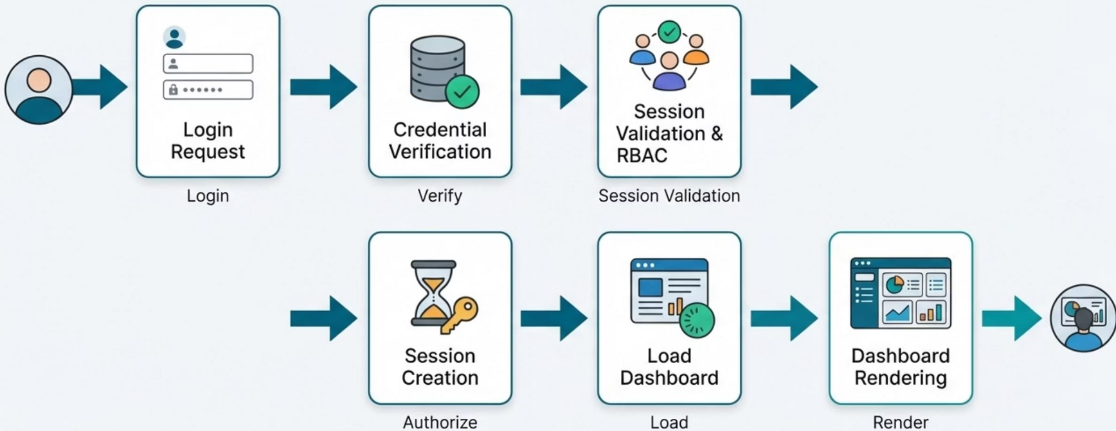
Secure & Standardized User Interaction
Every user journey follows a consistent, secure process of authentication, authorization, and content delivery.
Login Request
User initiates login.
Credential Verification
System verifies user credentials.
Session Validation & RBAC
Session validation and role-based access control.
Content Delivery
Authorized content is loaded and rendered.

Slide 6

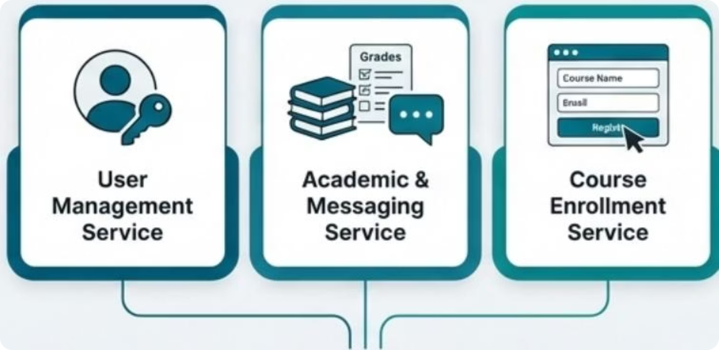






Decoupled Microservice Architecture
System logic is decoupled into distinct, independently manageable services for modularity and scalability.
User Management Service
Academic & Messaging Service
Course Enrollment Service
Handles user identity, authentication, and profiles.
Manages student course registration logic and process.
Manages course data, grades, and internal communication.

Slide 7

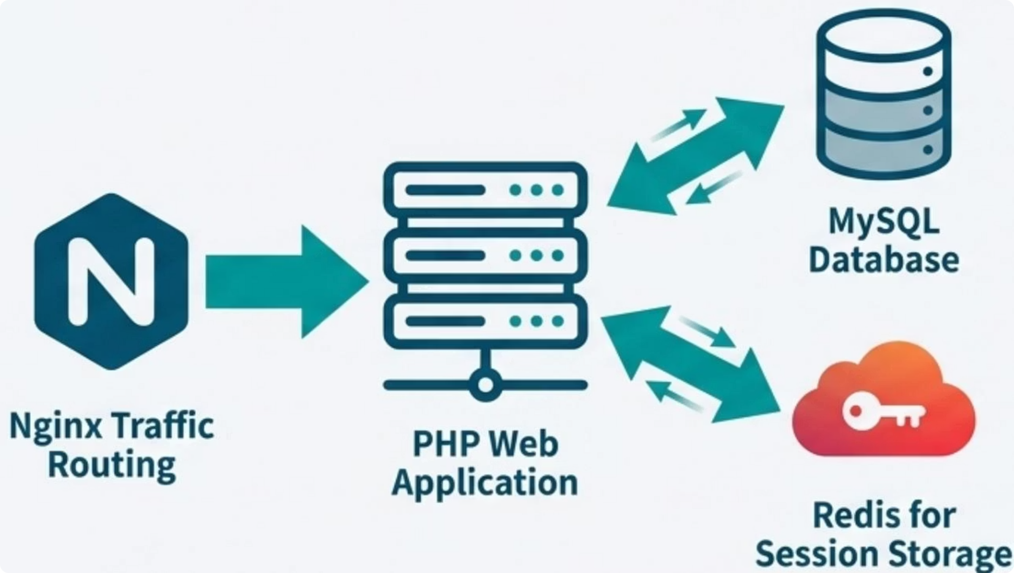
Efficient Core Engine: Traffic & Data Flow
Incoming requests are handled by a high-performance routing and application stack, using a hybrid storage model.
Nginx Traffic Routing
Hybrid Storage Solution
Entry point for efficient routing of HTTP traffic to the web application.
MySQL Database: Persistent storage for critical data (users, courses, grades).
PHP Web Application
Redis for Session Storage: High-speed, in-memory cache for session management and authentication.
Core engine processing business logic and interacting with data stores.

Slide 8
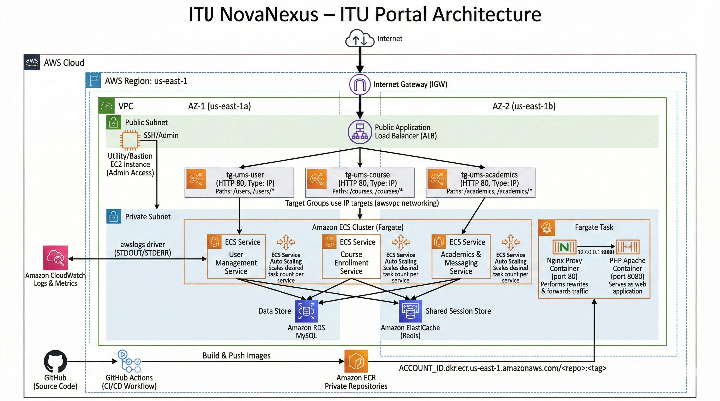

Slide 9




Scalable, Serverless AWS Cloud Foundation
ITU NovaNexus is deployed in us-east-1 AWS region, leveraging multi-AZ, serverless architecture for high availability, fault tolerance, and automatic scaling.
Traffic Entry & Distribution
Managed Data Layer
Internet Gateway and Public ALB distribute traffic across AZs using path-based routing.
Multi-AZ Amazon RDS (MySQL) for persistent data and Amazon ElastiCache (Redis) for high-speed caching.
Scalable Compute
Network & Security
Microservices run as Docker containers orchestrated by Amazon ECS with Fargate for serverless scaling.
Stack within VPC, private subnets for services, bastion host for SSH access.

Slide 10


CI/CD Pipeline Automates Deployment
A fully automated Continuous Integration and Continuous Deployment (CI/CD) pipeline ensures rapid and reliable updates via GitHub Actions.
01
02
Code Push
Build Docker Images
Developers push source code changes to GitHub.
GitHub Actions workflow builds Docker images for services.
03
04
Store Images
Deploy New Version
Built Docker images are pushed to Amazon ECR.
Workflow triggers an update to Amazon ECS services, deploying the new application.

Slide 11
Architecture Delivers High-Performance Results
Microservices, efficient caching, and a scalable cloud foundation result in a highly responsive user experience.
~150ms
200-500ms
Dashboard Loads
URL Redirects
Achieved through high-speed session and data retrieval from Redis and optimized database queries.
Handled efficiently by the Nginx reverse proxy and Application Load Balancer routing.

Slide 12



Built with a Modern, Industry-Standard Technology Stack
The development and deployment of ITU NovaNexus leverages a comprehensive suite of modern tools and platforms, ensuring robustnes5, maintainability, and scalability.
Backend & Framework
Containerization
QR
Lorovel
docker
Web Server/Proxy
Databases
Databased
redis
ty* Xleboc
Cloud Platform
aws db
CI/CD & Version Control
@ git
AP1Deve!opment
IDE

Slide 13




Conclusion: A Transformative, Future-Ready System
1. Efficiency & Integration
2. Scalable Performance
3. Enhanced User
Experience
Unified workflows stream(ine operations.
Data silos are eliminated.
Reduced manual redundancy.
Cloud-native architecture adapts to growth.
High availability is ensured.
A future-prooffoundation is
established.
Intuitive, sing(e-portal access.
Improved engagement & satisfaction.
Simplified navigation.
Overall Impact: The ITU NovaNexus project successfully delivered a unified, scalable, and ekicient platform that streamlines university operations and enhances the user experience for all stakeholders.
Scan to view project
repository

